Slide 1
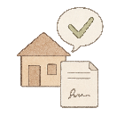

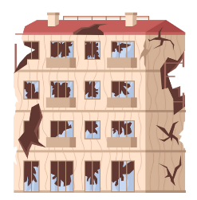
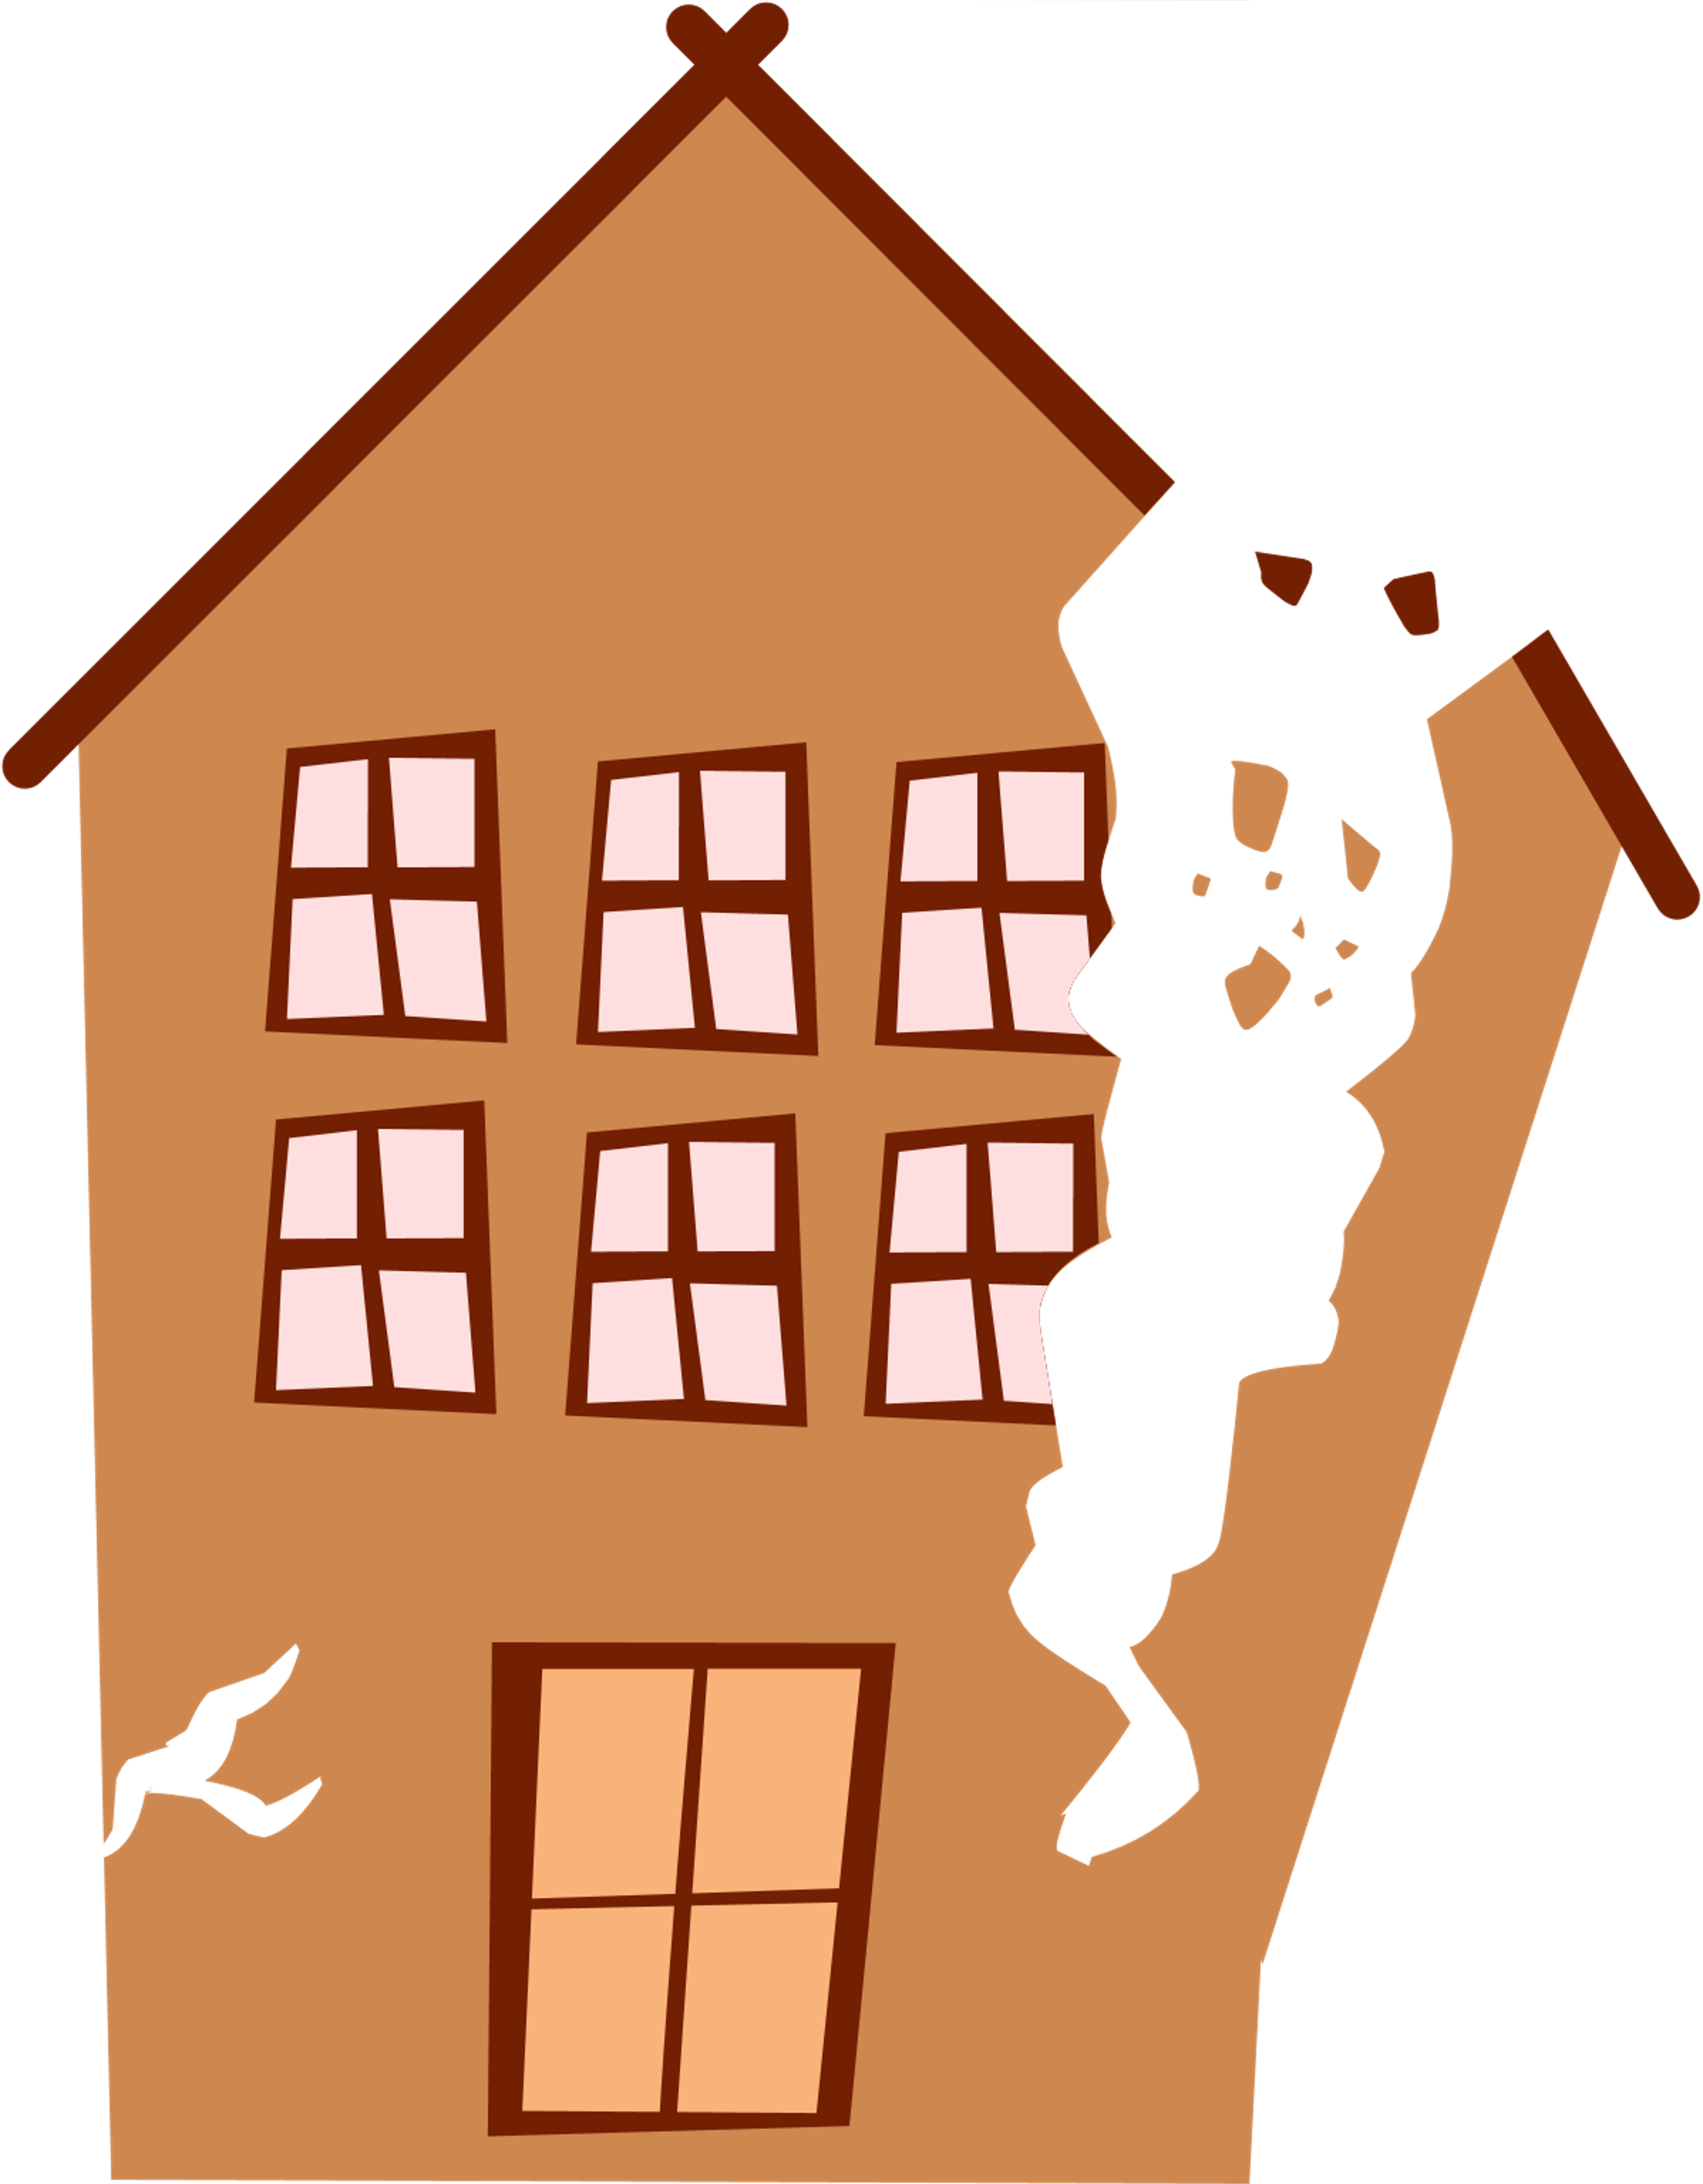
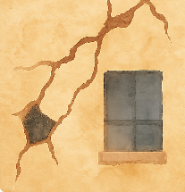
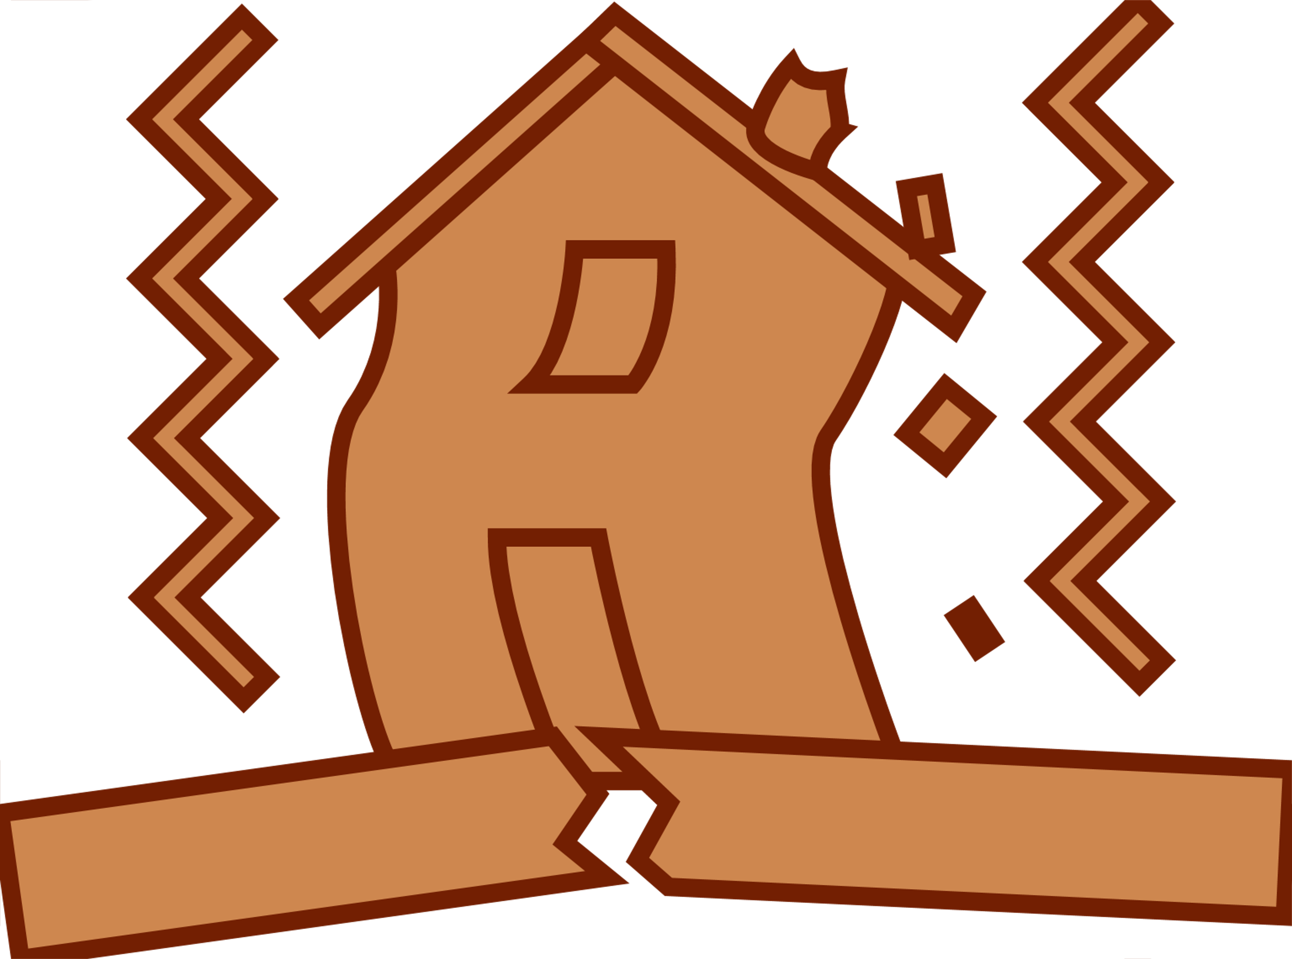






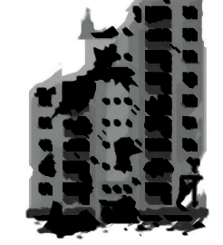

Guidance for the Temporary Occupancy of Damaged Buildings
A. Before using any house or property
Ask for permission from the owner
Written permission, or a verbal agreement.
Assess the damage, as best you can
Liability Disclaimer
This guidance is intended for basic, household-level visual checks only. It does not constitute structural or safety certification and cannot guarantee a building is safe to enter or occupy. Conditions may change suddenly and without warning.
A full damage assessment by qualified professionals is required to verify structural stability.
If any sign of serious danger is present, do not enter and seek qualified professional assistance if available.
Carefully assess the safety of your home.
B. Outside Check
Walk around the building (if possible)
Look for major structural issues.
Check adjacent buildings that could pose a hazard if they collapse onto your structure.
DO NOT ENTER IF YOU SEE:
This guidance is developed by:
Parts of the
building collapsed
or leaning ​
Deep cracks
in exterior
walls
Leaning
or bulging walls
Loose & large pieces at risk of falling.
Burnt buildings are
…DANGEROUS…
even if they are still standing.
Due to: Collapsing debris, hazardous materials, structural damage
GAZA Shelter Response - September 2025
Note: This tool offers basic guidance only and is not a substitute for expert structural assessment. (Partners to insert hotline or contact information)
Notes:
Body Text
10 pt to 11 pt – Ideal for standard reading comfort.
Use 11 pt if your audience might prefer slightly larger text (e.g., older readers).
Use 10 pt for more compact layouts or technical content.
Headings
Main Title: 18–24 pt
Section Headings: 14–16 pt
Subheadings: 12–14 pt
Captions / Footnotes
8–9 pt – Small but still readable.

Slide 2
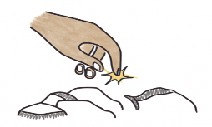


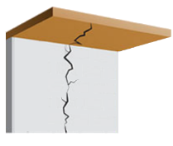
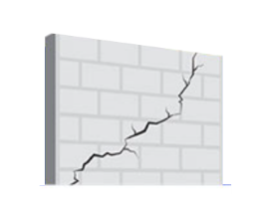
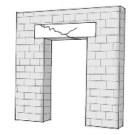

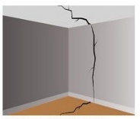
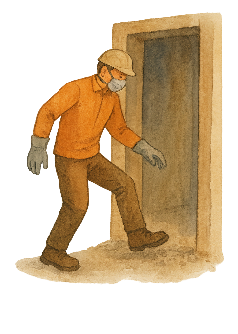

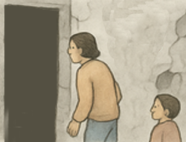
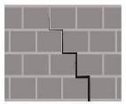
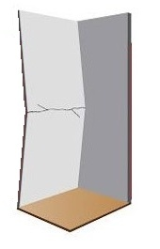


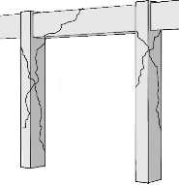


1. Check slab & beam
Are any beams or slabs cracked or bending?
Initial Visual Inspection
Do not touch unidentified objects, they may be unexploded ordnance, and ensure your family, including children, are warned not to approach or handle them.
Contact Civil Defence to inform of the unexploded ordnance.
Consider the whole building, not just the rooms you want to occupy.
Are there STRUCTURAL cracks??
2. Inspect walls in each room
C. Inside Check
Especially at corners of doors or windows
If the exterior seems sound:
Enter the building during daylight.
Wear sensible clothing, or proper protective clothing if available. Cover your mouth and nose before entering.
Wall to slab cracks
Diagonal Cracks
Floor and slab cracks
Cracked Lintel
Check stability with your foot before fully standing in a specific area.
Always enter with someone else
!! BUT NOT CHILDREN !!
BE CAREFUL of any exposed electrical
cables or damaged appliances.
Stairstep crack in brick or masonry
Bowed wall
Cracked or shifted column
Column to beam cracks
LISTEN for unusual noises such as creaking, cracking, popping.
Check for signs of water infiltration or soil erosion around the base or foundations
Carefully inspect the slabs, columns, beams, and walls. Do not occupy the space unless you are certain it is structurally safe.
Note: This tool offers basic guidance only and is not a substitute for expert structural assessment. (Partners to insert hotline or contact information)
2
Note: This tool offers basic guidance only and is not a substitute for expert structural assessment. (Partners to insert hotline or contact information)

Slide 3
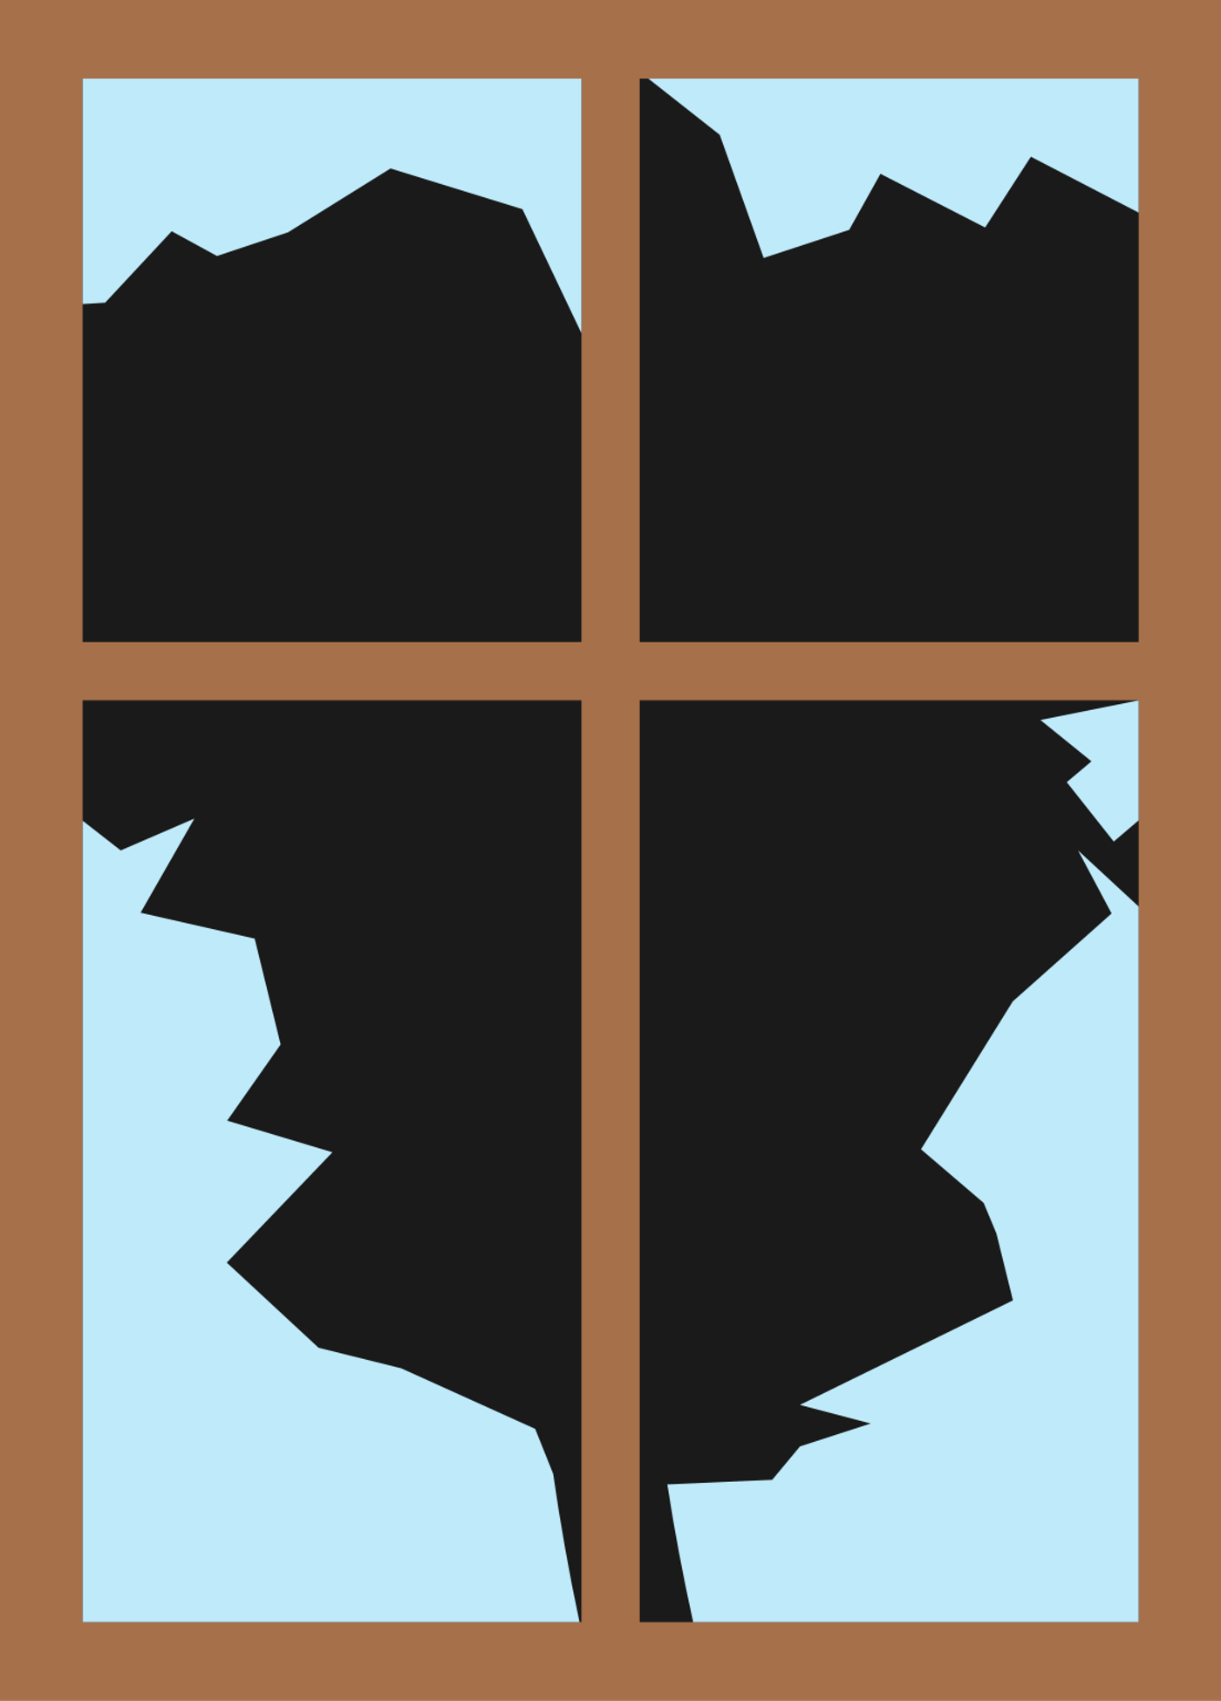
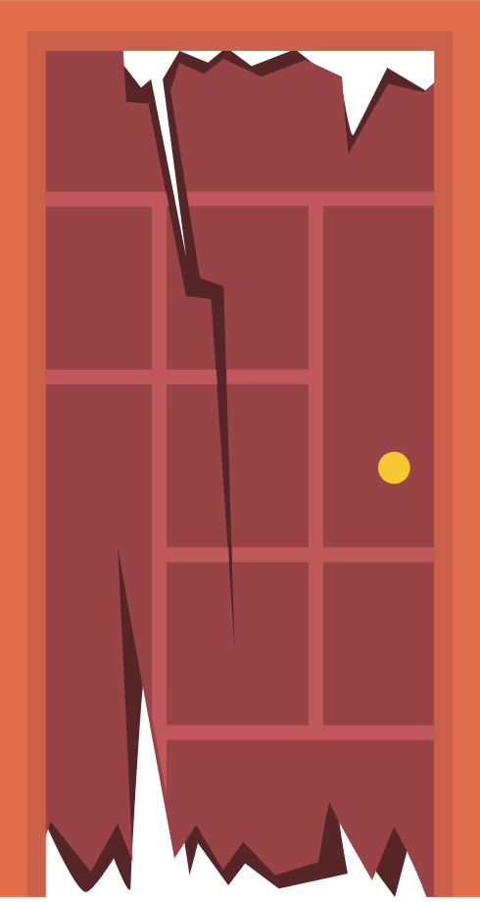
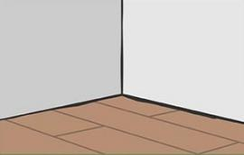
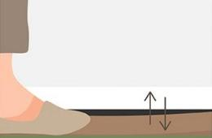



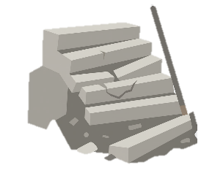

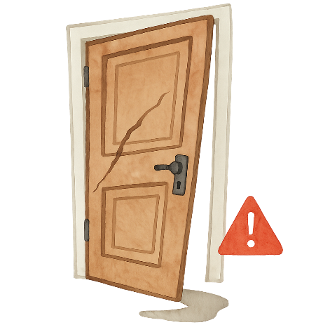





3. Check floors & roof
5. Check doors & windows
Do the floors feel soft? Or sagging?
Floor and wall gaps
Sagging floors
They could collapse or crumble further if stepped on.
Proceed only if you are confident that it is safe.
Cracked or shattered glass or wood.
Loose or hanging frames.
Difficulty opening or closing.
Sharp edges or debris around openings.
Signs of structural damage around the window area
4. Check stairs
Loose or broken steps.
Cracks in the stair structure or supports.
Badly fitting doors (e.g. a door that jams or doesn’t fit its frame) can be a sign the building has shifted.
Signs of shifting or tilting.
Clear debris carefully, as they may pose a tripping hazard.
Avoid stairs lead to upper floors of the building with visible damage
Note: This tool offers basic guidance only and is not a substitute for expert structural assessment. (Partners to insert hotline or contact information)
4
Note: This tool offers basic guidance only and is not a substitute for expert structural assessment. (Partners to insert hotline or contact information)

Slide 4




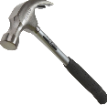


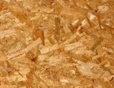
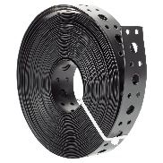

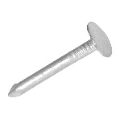
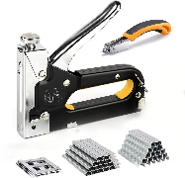
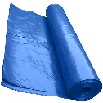
Expanded Sealing Off Materials
HAND SAW
total length 60 cm, for wood, good quality, tempered, hardened and set teeth. Unbreakable handle.
2 pcs
ROPE
Minimum 30 meters length, in roll, 6mm thickness.
1 roll
These materials are recommended for emergency repairs. Partners are encouraged to modify the quantities below based on the materials and resources available to them.
Essential Components
TIMBER BATTEN
5x2.5cm, useful for creating dividing partitions, fixing tarpaulin and sheet to walls. 2.4m lengths.
20 pcs
NAILS 50mm
For timber connections. Used for making frames and fixing cover-battens.
0.5 kg
MEASURING TAPE
3 meters, graduated in centimetres.
1 pcs
HAMMER
Metal or fiberglass handle.
1 pcs
NAILS 75 mm
For timber connections. Used for making frames and fixing cover-battens.
Optional Components
TARPAULINS
woven plastic, available in sizes of 6x4 meters, 5x4 meters, or as a roll of 4 meters width. They can be used for roofing, walls and covering openings/windows
3 pcs
0.5 kg
TIMBER SHEET - PLYWOOD OR OSB
Approx. 1 cm thick, used for internal partitions, covering openings etc. 2.4x1.2 m.
32 pcs
METAL FIXING BAND
10m roll, 20mm width x 0.9 thick. Useful for general purpose fixing band.
1 pcs
Clout nails 40mm
For timber connections. Used for making frames and fixing cover-battens.
0.25 kg
SCALPEL
Precision cutting tool with replaceable blade. Used for fixing tarpaulins.
1 pcs
PLASTIC SHEET
0.3mm thick, roll is up to 50sqm per shelter. Minimum width 4m.
1 roll
Note: This tool offers basic guidance only and is not a substitute for expert structural assessment. (Partners to insert hotline or contact information)
6
Note: This tool offers basic guidance only and is not a substitute for expert structural assessment. (Partners to insert hotline or contact information)

Slide 5

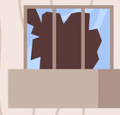

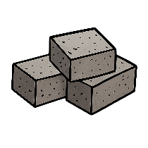



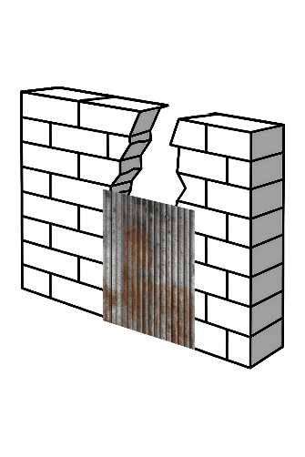
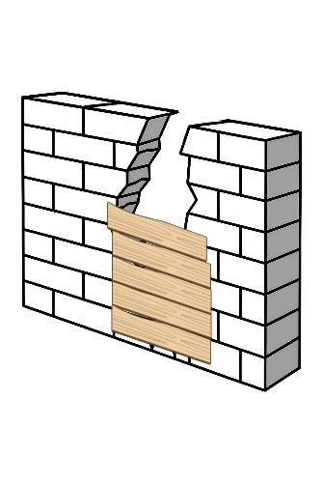
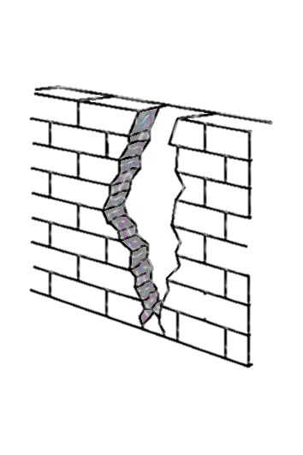



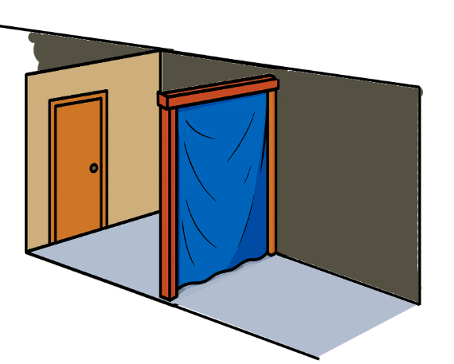
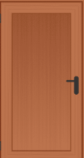
Sealing off openings
Sealing off large gaps or collapsed areas
Wear gloves &
carefully remove shattered glass
Keep children away from insecure windows
Rebuild with:
Salvaged blocks ​
Cement & sand
Mud & straw
Secure tarpaulin
Use timber & nails or ropes to tightly cover the opening.
Add barrier
Install a railing to prevent accidents
If blocks are unavailable, use:
1m
CGI sheets
Wooden boards
Tightly secure fabric/tarpaulin
Sealing-off internal walls
Reuse old doors
Adjust them to fit the size of the openings
Use fabric, tarps, old doors, or wood to create privacy in damaged spaces.
Note: This tool offers basic guidance only and is not a substitute for expert structural assessment. (Partners to insert hotline or contact information)
8
Note: This tool offers basic guidance only and is not a substitute for expert structural assessment. (Partners to insert hotline or contact information)

Slide 6
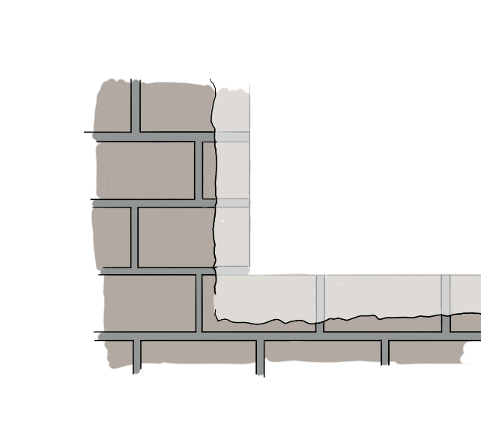

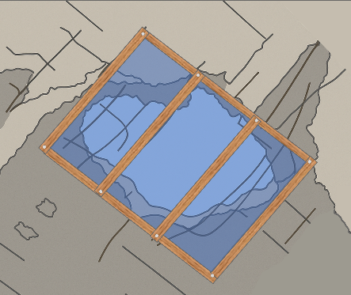
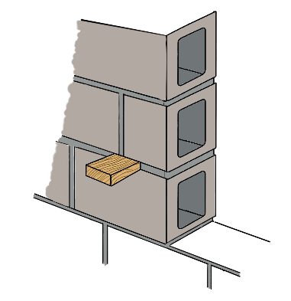
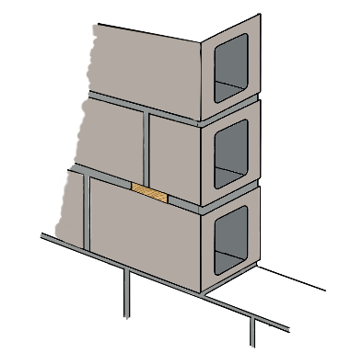
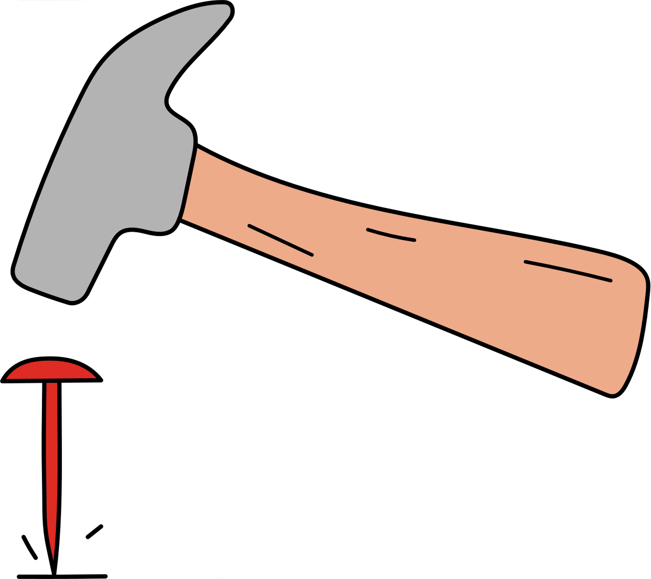

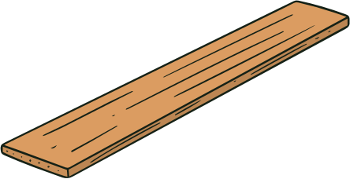

Sealing off roofs
When fixing a timber batten to blockwork wall:
Cover holes with metal sheets or tarpaulin.
For large gaps, use wooden beams and secure tarps with rope or wire.
Tarps provide shade,
rain protection, and privacy.
How to fix timber to blockwork?
Try nailing into the mortar joints
Try using metal straps to get a good fixing
If it is difficult to get a good fixing to blockwork, try using a wooden wedge.
When fixing a tarpaulin to blockwork wall:
Wrap around a timber batten
Use a timber batten
1. Hammer the wedge into a joint in the blocks
2. Cut it off flush
3. Nail the batten to the wedge
This method can be also applied with clout nails or scalpel
Note: This tool offers basic guidance only and is not a substitute for expert structural assessment. (Partners to insert hotline or contact information)
10
Note: This tool offers basic guidance only and is not a substitute for expert structural assessment. (Partners to insert hotline or contact information)

Slide 7



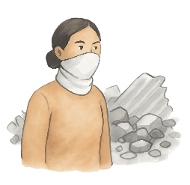
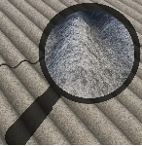
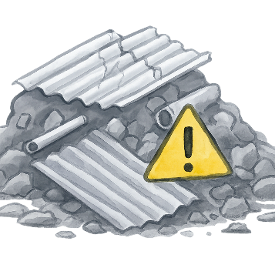

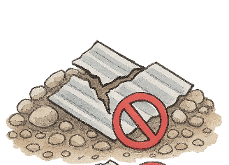
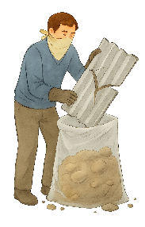
Safe handling of Asbestos
Asbestos should preferably be handled by experts due to associated health risks.
Content adapted from
Recognising Asbestos
How to remove asbestos panels?
Protect your mouth and nose with a mask using a t-shirt or fabric across your mouth and nose.
Do not break it up into pieces. Avoid creating dust .
In Gaza, the most common asbestos is found in roofing sheets, mainly in refugee camps.
Corrugated cement-like panels with a wavy, corrugated profile
Cloudy grey, sometimes with rough, grainy, or speckled patches caused by aging cement and exposed fibers.
Put it in a plastic bag –and then put that plastic bag inside another plastic bag (double bagging). Seal with some tape if you have it. ​
Health Risks
When finished dispose the mask in the 2nd bag.
When asbestos-containing materials are disturbed, tiny fibres are released into the air.
If inhaled → Serious health issues such as cancer.
Disposal of Asbestos
Put the asbestos bags to one side for later collection.
Note: This tool offers basic guidance only and is not a substitute for expert structural assessment. (Partners to insert hotline or contact information)
12
Note: This tool offers basic guidance only and is not a substitute for expert structural assessment. (Partners to insert hotline or contact information)

Slide 8
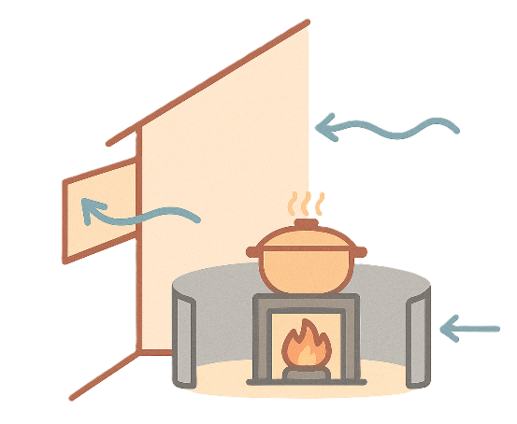
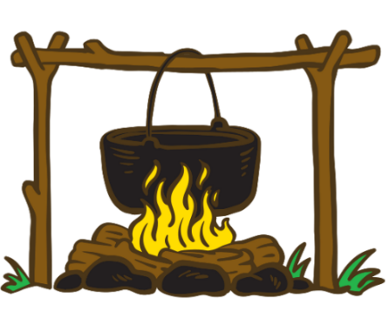




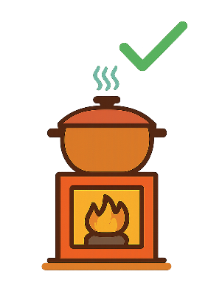
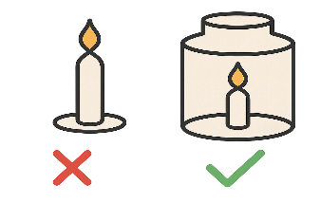



COOKING AND LIGHTING – FIRE PREVENTION AND HEALTH RISKS
Don't let the stove unattended
Use a metal/ clay barrier around the stove if available
Keep distance between the walls and the stove
Ensure ventilation while cooking
It’s best to cook in outdoor areas, away from any flammable materials, to reduce the risk of fire.
Ensure the stove is turned off completely after use.
Keep in mind:
If it's not possible and you have to cook inside the same area you're occupying, make sure to:
Be aware of fire and health risks such as oil or kerosene lamps and candles.
If candles are used, try to secure them in a non-combustible holders.
Keep the fire away from any flammable materials and children.
Avoid an open flame
Keep the flame enclosed in a stove or metal cage
Raise the stove using bricks
Note: This tool offers basic guidance only and is not a substitute for expert structural assessment. (Partners to insert hotline or contact information)
14
Note: This tool offers basic guidance only and is not a substitute for expert structural assessment. (Partners to insert hotline or contact information)

